Slide 1
TEXT-TO-IMAGE USING STACK-GENERATIVE
ADVERSARIAL NETWORKS (GAN)
Presented By : Saravanan B
Register No. : 711721243095
Department : B .Tech Artificial Intelligence and Data Science
3/21/2024 Annual Review

Slide 2
PROJECT TITLE
Text-To-Image using Stack-GAN
3/21/2024 Annual Review

Slide 3


AGENDA
Problem Statement
Project overview
End Users
Solution and Its value proposition
Special in Solution
Modelling
Result
3/21/2024 Annual Review

Slide 4

PROBLEM STATEMENT
Generating realistic images from textual descriptions, known as Text-To-Image synthesis, poses a significant challenge due to the semantic gap between text and visual content. Existing methods often struggle to produce high-quality images that accurately represent the provided descriptions. In this project, our objective is to address this challenge by developing a Text-To-Image synthesis system using Stack-Generative Adversarial Networks (GANs)
3/21/2024 Annual Review

Slide 5

PROJECT OVERVIEW
The project focuses on building a system that can generate realistic images from textual descriptions using Stack-Generative Adversarial Networks (GANs). This involves implementing the Stack-GAN architecture, which comprises multiple stages for refining generated images progressively. The system will take textual descriptions as input and produce corresponding high-quality images that closely align with the provided descriptions.
3/21/2024 Annual Review

Slide 6

WHO ARE THE END USERS?
Content Creators
E-commerce Platforms
Virtual Reality (VR) and Augmented Reality (AR) Developers
Educators and Researchers
Storytellers and Writers
Social Media Platforms
Automated Content Generation Platforms
3/21/2024 Annual Review

Slide 7

YOUR SOLUTION AND ITS VALUE PROPOSITION
SOLUTION :
The proposed solution is efficiently translates textual descriptions into realistic images by leveraging a shared latent space between text and images. By employing the multi-stage refinement process of Stack-GANs, our system produces high-quality, contextually relevant images with fine-grained details. This solution enhances creativity, streamlines content creation processes, and improves user engagement across various applications and industries.
3/21/2024 Annual Review

Slide 8
VALUE PROPOSITION:
Bridge semantic gap between text and images.
Generate high-quality, realistic images from textual descriptions.
Enhance creativity and efficiency in content creation.
Improve user engagement through visually compelling content.
Drive innovation and advancement in Text-To-Image synthesis.

Slide 9

THE WOW IN YOUR SOLUTION
UNIQUE FEATURES OF OUR SOLUTION:
Progressive refinement with Stack-GAN architecture.
Shared representation for text and images.
Contextually relevant image generation.
User-friendly interface.
Superior performance and quality
3/21/2024 Annual Review

Slide 10
MODELLING
Teams cam add wireframes
Modeling Explanation:
Data Preprocessing:
Gather a dataset containing paired textual descriptions and corresponding images.
Preprocess textual descriptions by tokenization and embedding to create suitable input representations.
Resize and normalize images to ensure uniformity in input data.
Generator Architecture:
Implement a hierarchical generator architecture with multiple stages.
Each stage takes as input the textual description and produces an image with increasing resolution and detail.
Utilize techniques such as convolutional neural networks (CNNs) and recurrent neural networks (RNNs) to capture both global context and fine-grained details.
Discriminator Architecture:
Design a discriminator network to distinguish between real and generated images.
Train the discriminator to classify images as real or fake using techniques like CNNs with binary classification output.
Training Procedure:
Initialize the generator and discriminator networks with appropriate weights.
Alternately train the generator and discriminator in an adversarial manner.
For each training iteration:
Feed textual descriptions into the generator to produce generated images.
3/21/2024 Annual Review

Slide 11
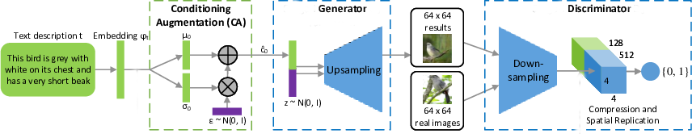
2. Train the discriminator with both real images from the dataset and generated images, adjusting its parameters to improve classification accuracy.
3. Train the generator to generate images that fool the discriminator, adjusting its parameters to produce more realistic images.
5.Evaluation:
Evaluate the trained model using both quantitative metrics (e.g., Inception Score, Frechet Inception Distance) and qualitative assessment.
Assess the quality, diversity, and relevance of generated images compared to ground truth images and alternative methods.
Iterate on the model architecture and training procedures based on evaluation results to improve performance.
6.Deployment and Integration:
Deploy the trained model in a production environment, making it accessible via APIs or integration into existing systems.
Provide a user-friendly interface for users to input textual descriptions and generate corresponding images.
Continuously monitor and update the model to ensure optimal performance and reliability in real-world applications.

Slide 12
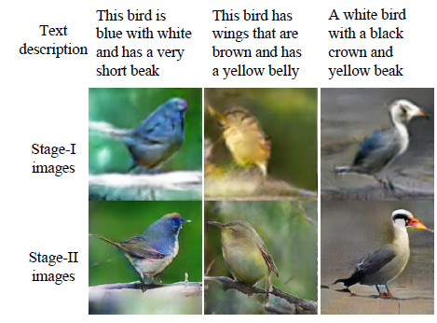
RESULTS
Demo Link
3/21/2024 Annual Review

Slide 13
CONCLUSION
In summary, our Text-To-Image synthesis system, powered by Stack-Generative Adversarial Networks (GANs), excels in translating textual descriptions into realistic images. Through a hierarchical generator architecture and adversarial training, it effectively captures semantic nuances and produces high-quality outputs. With its user-friendly interface and broad applications, this system showcases significant potential for various industries, while continued research promises to further refine its capabilities and drive innovation in image synthesis techniques

